Slide 1
変動帯テクトニクス

Slide 2
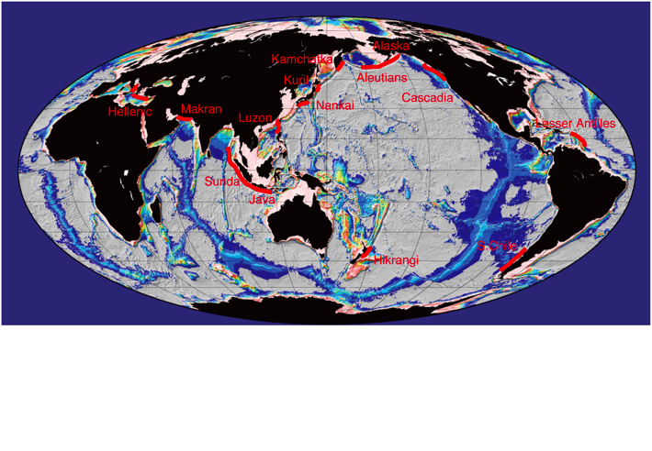
Plate Boundary Processes
Subduction & Collision Zone

Slide 3
Target subduction zone
1. Chile trench
2. Middle America trench and Barbados
3. Cascadea trench
4. Mariana & Tonga Kermadic trenches
5. Sunda trench
6. Philippine & Manila trenches

Slide 4
Remarks and recent progress
1. Tectonic framework
2. Geomorphology
3. Seismicity and geodetics
4. Forearc geology
5. Gravity
6. Other remarks (accretion vs erosion, seamount collision, --arc juncture etc.--)

Slide 5
Google scholar
Look for best cited 5 papers covering the themes
Most recent paper covering the themes
Download PDFs and upload to Endnote
Make PPT file and present it in the class

